Slide 1

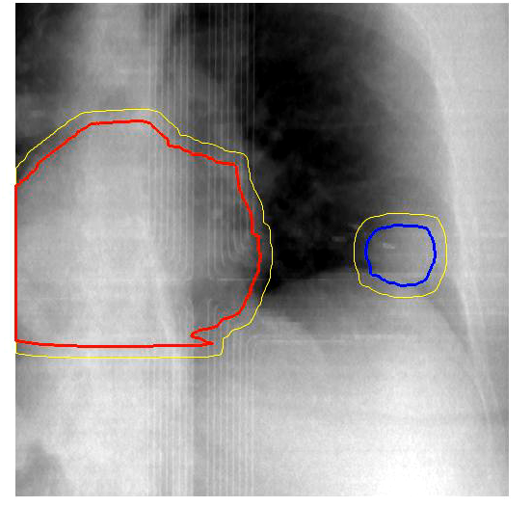
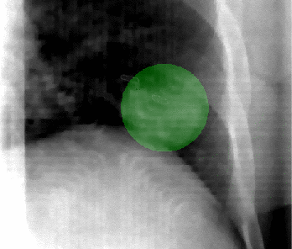
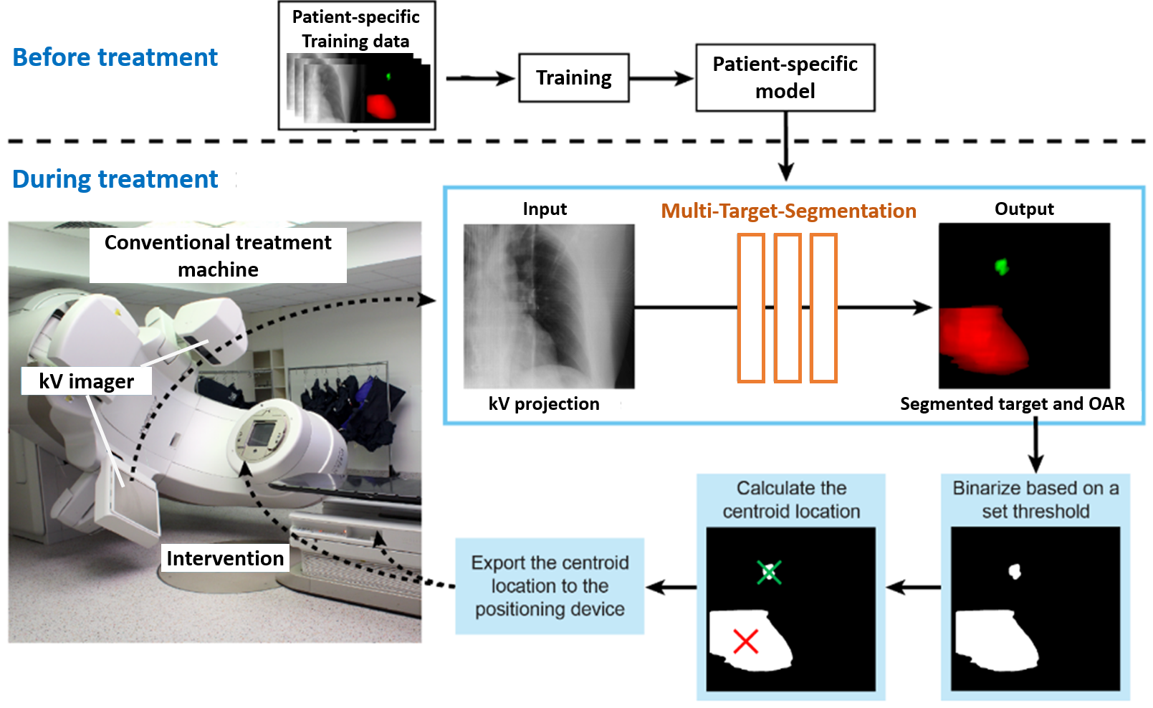
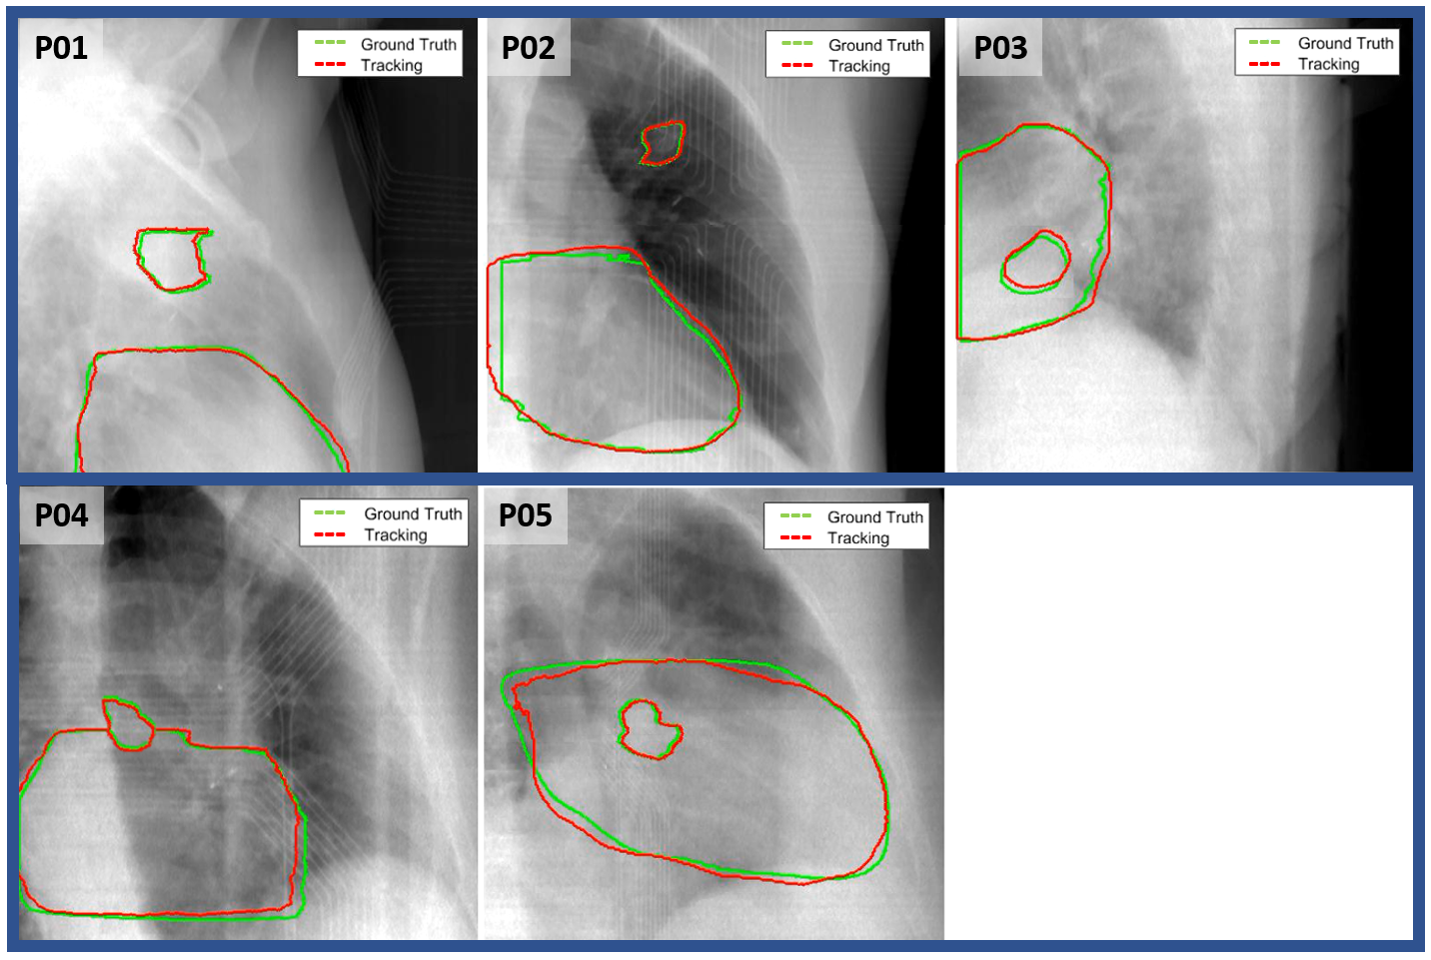
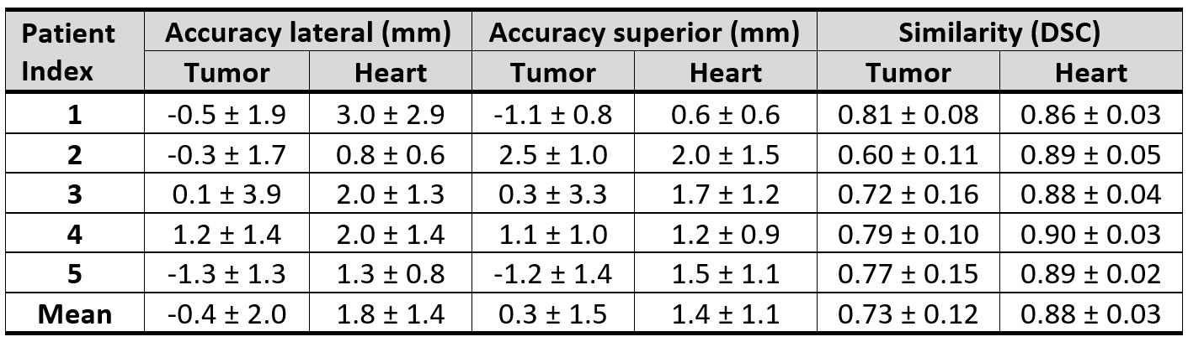

Increasing the precision of radiotherapy for tumours near critical organs at risk using machine learning
M. MUELLER ^{1,2}, A. MYLONAS ^{1,2}, P. KEALL ¹, J. BOOTH ³, D.T. NGUYEN ^{1,2,3}
1 ACRF Image X Institute, The University of Sydney, Australia
2 Department of Biomedical Engineering, The University of Technology Sydney , Australia
3 Northern Sydney Cancer Centre, Royal North Shore Hospital, Sydney, Australia
INTRODUCTION
MULTI-TARGET-SEGMENTATION (MTS)
Radiotherapy: Destroying invisible targets with an invisible beam Radiotherapy aims to destroy tumours by accurately depositing toxic radiation. However, patients move, breathe, and their hearts beat, causing motion during the radiation treatment¹. This limits treatment efficacy because harmful radiation is deposited less into the tumour and more into surrounding healthy tissues. Especially tumours in close proximity to critical Organs At Risk (OARs) are often not eligible for radiation therapy, because of the high risk for treatment side effects^{2,3}.
Clinical Rationale
Monitor patient inner anatomy with a standard treatment machine MTS can be integrated seamlessly into a standard clinical treatment workflow. MTS relies only on standard-equipped treatment system hardware and treatment planning data.
See what you treat MTS monitors tumour and surrounding OARs motion during a standard rotational radiation treatment.
MTS enables treating tumours in close proximity to critical structures and data-driven decision making for treatment interventions at the time it is needed most – in real-time during treatment.
Focus on the patient MTS uses data augmentation to allow clinical setup uncertainties of <3mm for improved clinical feasibility. Network training is conveniently accomplished prior to the treatment day.
Heart
Margin
Tumour
OAR
Tumour
Technical Realisation
Patient-specific Model
MTS is trained on a patient-specific dataset of synthetic kV-projections created from the planning 4D-CT phases. MTS is then applied to real kV-projections.
Seamless integration
In a clinical implementation MTS receives kV-projections from the on-board kV imager during treatment. Tumour and OARs are segmented in <50ms. Locations and deviations from the treatment plan are exported to the treatment system for potential treatment intervention.
Radiation zone
RESULTS
Applied Machine Learning
A Convolutional Neural Network (CNN) forms the centre piece of MTS. The CNN is tuned for robust unsupervised-learning on multi-channel images.
Radiotherapy with MTS: Destroying invisible visible! targets with an invisible beam
Project Timeline
For today’s presentation, MTS was applied to simultaneously segment the tumour and the heart in kV-projections of 15 treatment fractions of five lung cancer radiotherapy patients. The geometric accuracy of MTS was determined as the mean difference between the centroids of the segmented structures and their respective manually-created ground-truth. The 2D segmentation similarity was determined by the dice-similarity-coefficient (DSC).
TODAY
MTS (red) compared to the ground truth (green) segmentation of tumour and heart in kV-projections of five patients.
2020
2021
2021/2022
future
Proof of concept on CBCT projections
First prospective implementation on a clinical system in phantom experiments
Improving robustness on large patient cohort
First patient treatment in a phase 1 clinical trial
MTS localised the tumour during treatment with an accuracy of -0.4±2.0mm and 0.3±1.5mm in the lateral/anterior-posterior and superior-inferior directions, respectively.
The heart localisation accuracy was 1.8±1.4mm and 1.4±1.1mm, respectively.
The mean segmentation similarity was 73±12% for the tumor and 88±3% for the heart.
CONCLUSIONS
MTS achieved clinically relevant segmentation accuracy for clinical deployment!
MTS may widen the therapeutic index of radiotherapy for tumours close to critical OARs.
Simultaneous target and OAR localisation during a standard radiotherapy workflow is feasible.
MTS is an affordable technique compatible with 95% of existing radiation therapy treatment systems.
MTS potentially improves tolerance and reduces side effects of radiotherapy for cancer patients.
REFERENCES
1. Suh Y, Dieterich S, Cho B and Keall P J 2008 An analysis of thoracic and abdominal tumour motion for stereotactic body radiotherapy patients Phys. Med. Biol. 53 3623
2. Senthi S, Haasbeek CJ, Slotman BJ, Senan S. Outcomes of stereotactic ablative radiotherapy for central lung tumours: a systematic review. Radiotherapy and Oncology. 2013;106(3):276-282.
3. Henke, L.E., Olsen, J.R., Contreras, J.A., Curcuru, A., DeWees, T.A., Green, O.L., Michalski, J., Mutic, S., Roach, M.C., Bradley, J.D. and Parikh, P.J., 2019. Stereotactic MR-guided online adaptive radiation therapy (SMART) for ultracentral thorax malignancies: results of a phase 1 trial. Advances in radiation oncology, 4(1), pp.201-209
Marco Mueller
Phd student | ACRF Image X InsTitute
Marco.mueller@sydney.edu.au

